Slide 1
Input and Output
Chapter 3

Slide 2
Chapter Topics
I/O Streams, Devices
Predefined Functions
Input Failure
Formatting Output
Formatting Tools
File I/O

Slide 3
I/O Streams, Devices
Input stream
  A sequence of characters/bytes
  From an input device
  Into the computer
Output stream
  A sequence of characters/bytes
  From the computer
  To an output device

Slide 4


Input Streams
Input data is considered to be an endless sequence of characters/bytes coming into a program from an input device (keyboard, file, etc.)
... 1 4 19 34 HI MOM. 7 ..

Slide 5
cin and the Extraction Operator >>
A binary operator
  Takes two operands
  Name of an input stream on the left
    cin for standard input from keyboard
  Variable on the right
Variables can be "cascaded"
cin >> amount >> count >> direction;
Variables should generally be simple types

Slide 6
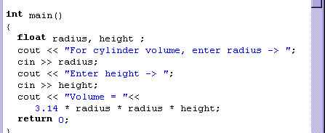
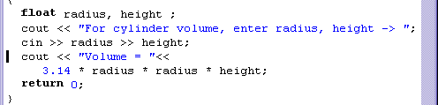
The Extraction Operator >>
Enables you to do input with the cin command
Think of the >> as pointing to where the data will end up
C++ able to handle different types of data and multiple inputs correctly

Slide 7
The Reading Marker
During execution of a cin command
  as long as it keeps finding data, it keeps reading
  when the reading marker hits something not data, it quits reading
Things in the input stream that cin considers not data
  spaces
  tab \t
  newline character \n
  (pressing the RETURN key)
  for numeric input, something nonnumeric

Slide 8
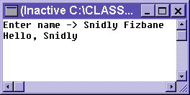
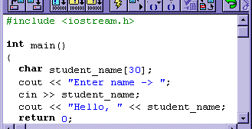
Reading cString Data with cin
Keyboard response of two words (separated by a space) causes the cin command to quit reading
  the space is considered nondata (in spite of our intent)
???

Slide 9
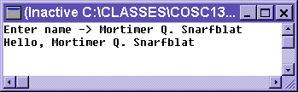
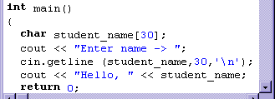
Reading cString Data
The getline ( ) function will allow the programmer to access all the characters
Character which terminates read
char Array variable
Length (max number of characters)

Slide 10
cin and the get Function
Syntax:
cin.get(varChar);
Example
cin.get (chVal);
  chVal is the parameter
  the .get function retrieves a character from the keyboard
  stores the character in chVal

Slide 11
cin and the ignore Function
Syntax:
cin.ignore (intValue, charVal);
Example:
cin.ignore (10,'\n')
The ignore function causes characters in the input stream to be ignored (discarded)
  In this example for 10 characters … or …
  Until a newline character occurs
  It also discards the newline character
The ignore and get also work for other input streams (such as file input streams)

Slide 12
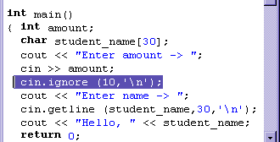
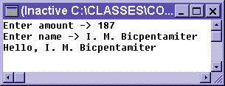
Using the ignore( )
Solution : the ignore( ) command
Tells the program to skip either the next 10 characters or until it reaches a newline
  whichever comes first
This effectively discards the newline

Slide 13
Input Failure
Happens when value in the input stream is invalid for the variable
int x, y;
cin >> x >> y; // Enter B 37
Value of 'B' not valid for an int
View example
When an input stream fails system ignores all further I/O

Slide 14
The clear Function
Use the clear to return the input stream to a working state
Example
look for
cin.clear()
cin.ignore (200,'\n');
// to empty out input stream

Slide 15
Formatting Output
Producing proper output in the proper format is important
  Specify decimal precision
  Specify left or right justification
  Align columns of numbers
C++ provides I/O manipulators
Syntax:
cout << manipulator << expression …

Slide 16
Manipulators
Must first of all
#include <iomanip>
For decimal precision use
cout << setprecision (n) << …
To output floating point numbers in fixed decimal format use
cout << fixed << …
To force decimal zeros to show
cout << showpoint << …

Slide 17
Manipulators
To specify right justification in a specified number of blanks use
cout << setw(n) << …
If the number of blanks required to print the expression exceeds specified size
  Size is ignored
Problem – print series of names left justified followed by right justified numbers
Osgood Smart 1.23
Joe Schmo 456.78
Names are of different length
Need variable number of spaces

Slide 18
Manipulators
Print name, then variable number of spaces using the setw( )
Example
cout << showpoint << fixed ;
cout << name <<
setw( 25 - strlen(name))<<" ";
cout << setw (8) <<
setprecision(2) << amt;

Slide 19
Formatting Tools
Possible to specify a character to fill leading spaces
cout.fill ('*');
cout << setw(10) <<
setprecision(2);
cout << pmtAmount ;
Result
*****12.34

Slide 20
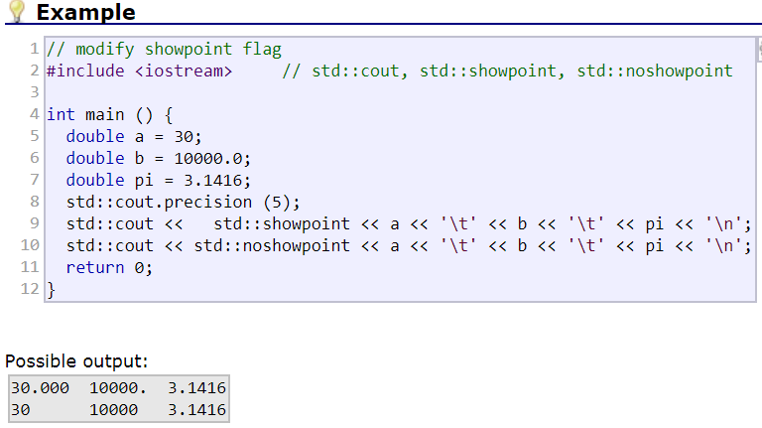

Slide 21
